Slide 1
SUN PHARMA STORES
A PHARMACY MANAGEMENT SYSTEM
GUIDED BY
PROF RATNAMALA PASWAN
AJAY rAO (31151)
CHINMAY MOTARWAR (31141)
ATHARVA SHASTRI (31159)
ROSHAN SHINDE (31160)

Slide 2
PROBLEM STATEMENT
To develop Pharmacy Management Database System for pharmacies to manage different inventories and items, storage regulation, customers and suppliers details.

Slide 3
ABSTRACT
Nowadays, Pharmacy management system is one of the most essential tools that are mostly used in medical store in India; it is mostly used to manage pharmacy related activities such as medical inventory, record keeping, sales management as well as managing the drug stock and information of the expired medicines. Many pharmacies in India are still operating manually; they don’t have adequate software to manage their daily activities. It needs the pharmacist assistant to check the expired date of the medicine twice a week, and it can take a lot of time to find out whether certain medicine are out of stock.
In this project we tried to develop a computerised based Pharmacy management system. Our main intention is to allow this application to be used in most retailing pharmacies in India, where a small point of customization will be required to each pharmacy in the implementation period. This system is designed to overcome all challenges related to the management of medicine that were used to be handled locally and manually.

Slide 4
OBJECTIVE
We plan to develop a database management system for the pharmacies. Pharmacies have a large number of different medicines which makes it difficult for the chemist/seller to quickly retrieve the medicine. What we plan to do is implement a database management system which help the pharmacists by digitalising all the manual work such as creating invoice, storing records etc. It will also help the pharmacist store the history of purchases of a person as it may be needed in the future.

Slide 5


PROGRAMMING LANGUAGES
Front End :
Back End :

Slide 6
FEATURES
We will present different view to the user in order to answer the queries which we have mentioned below:
Search for a medicine to check if the given medicine is available in the stock.
Breakage/Expiry view for updating stock in case of expiry and loss in transition.
History of Purchase by a particular customer.
View for purchasing medicines from different suppliers integrated with the product manager.
Sale view which could be deployed on different POS(Point of Sale) terminals.
Monthly Ledger generator(Monthly Profits) for generating accounting reports.
Slow Moving Stock to either discard the drug or increase its sale.

Slide 7
QUERIES
Creating purchase receipts
Purchase Receipts will have the following effect on the database, the DRUG relation will be updated using update when the purchase is completed. The SUPPLIES relation will also be updated with entries linking distributer, Drug, Qty.
Getting physical location about where medicine is present
This query will Select All Drugs to display list of all medicines and then use the select with ‘like’ to search the relation DRUG for the location of the required medicine.
Identifying medicines which are going to expire
This query will Select all name FROM DRUGS in which expiry_date.month() - current_date.month() < 6 or expiry_date.month() < input.month and expiry_date.year() < input.year.

Slide 8
Create Purchase Assistant
This query will compute the average of stock quantity and accordingly give the drug_id whose quantity is less than the average.
Purchase history
We will Select using patient ID from SELLS relation and then using the drug id calculate the profit made in the sale and display by grouping for a single patient on the sales made.
Gross profit sale Wise
For each sale We will query the SELLS relation for the various drug id and using them query the DRUGS relation to calculate the profit and then SUM up each of them using sale id.

Slide 9
Identify slow moving stock​
Select data from past sales from SELLS and DRUG. Using this data create a list of medicine which take a long time to sell and also lead to very low profits.
Monthly transactions summary​
Retrieve data from SELLS and DRUG relations corresponding to particular month. Then group the sales day wise. For each day report the total money earned by summing up the sales for that day.
Creating Sale Transactions​
Sale Transaction will effect the database such that the DRUG relation will be updated and new entry in customer(if a new customer) and in doctor(if a new doctor) and a new entry in SELLS will be added to corresponding relations.

Slide 10
CONSTRAINTS AND RELATION SCHEMA
1. Patient(Patient_ID,Name,Address,Contact,Email)
a. Patient_ID is primary key.
2. DOCTOR(Doctor_ID, Contact,Name, Specialisation, Hospital)
a. Doctor_ID is primary key.
3. PURCHASE(Date,Purchase_ID)
a. Purchase_ID is primary key.
4. SELLS(Sale_ID,Patient_ID,Drug_ID, Quantity, Date)
a. Sale_ID, Patient_ID, Drug_ID form primary key.
b. Patient_ID and Drug_ID are foreign keys.

Slide 11
5. PRESCRIBES(Patient_ID,Doctor_ID,Drug_ID)
a. Patient_ID,Doctor_ID,Drug_ID form primary key.
b. Patient_ID,Doctor_ID,Drug_ID are foreign keys.
6. DRUG1(type, cost_price, stock, drug_id, name, discount, mrp, expiry)
a. Drug_ID is primary key.
7. SUPPLIES(Quantity,Purchase_ID,Distributor_ID,Drug_ID)
a. Purchase_ID,Distributor_ID,Drug_ID form primary key.
b. Purchase_ID,Distributor_ID,Drug_ID are foreign keys.
8. DISTRIBUTOR(Distributor_ID,Contact, email)
a. Distributor_ID is primary key.
9. DRUG2(Type, Location)

Slide 12
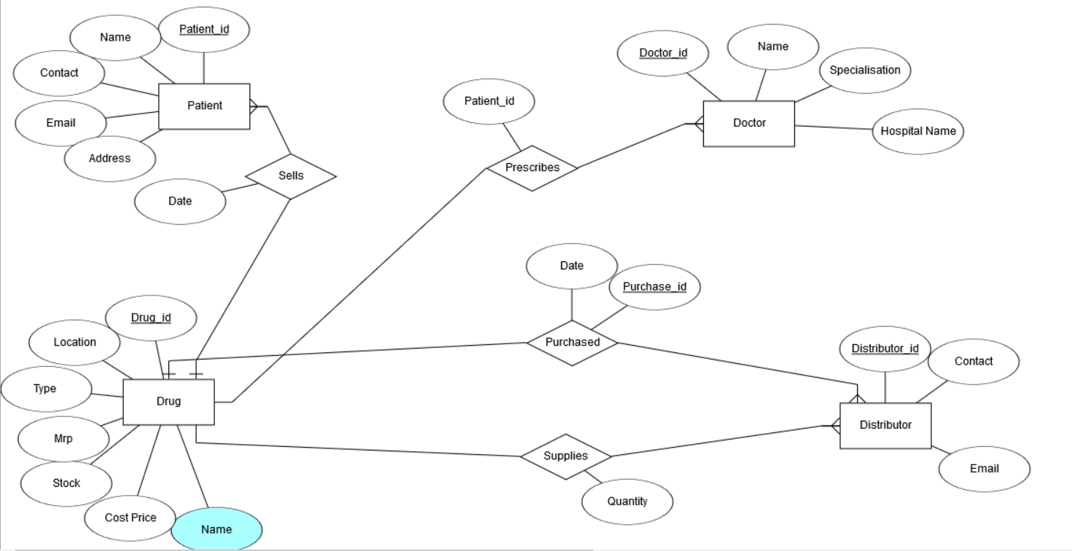
ER DIAGRAM

Slide 13
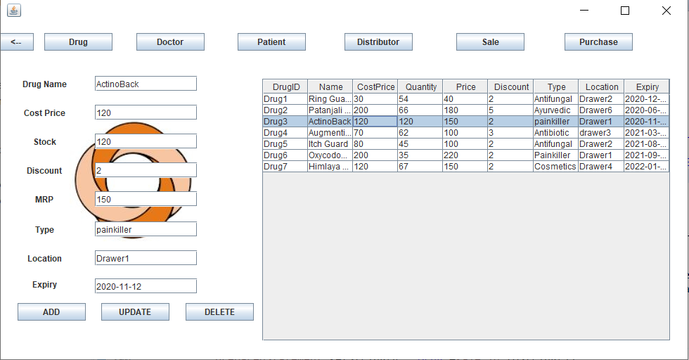
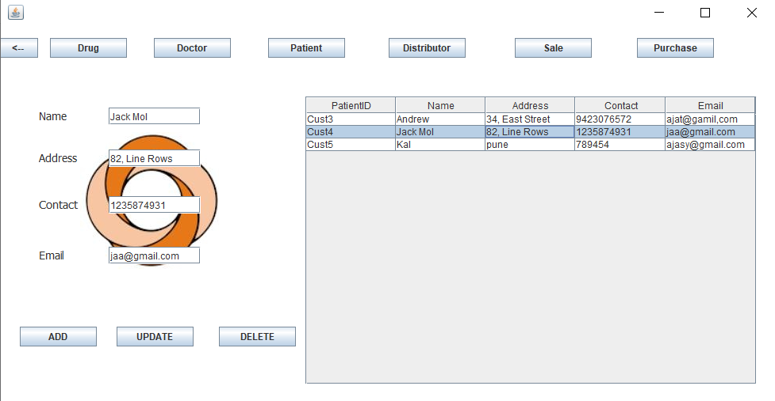
SCREENSHOTS
Drug Table
Patient Table

Slide 14
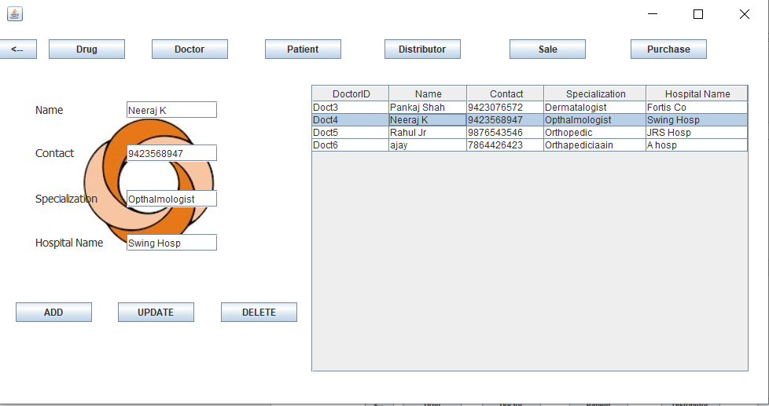
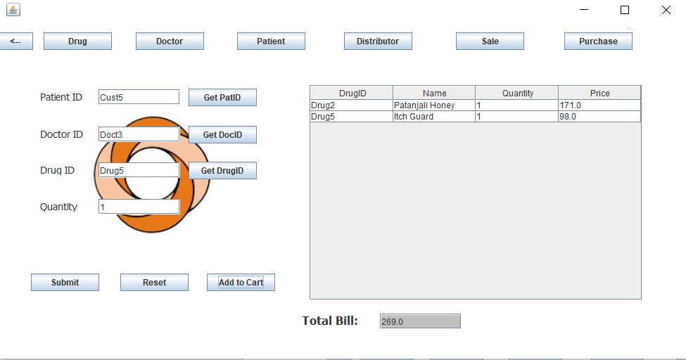
SCREENSHOTS
Doctor Table
Sales Table

Slide 15
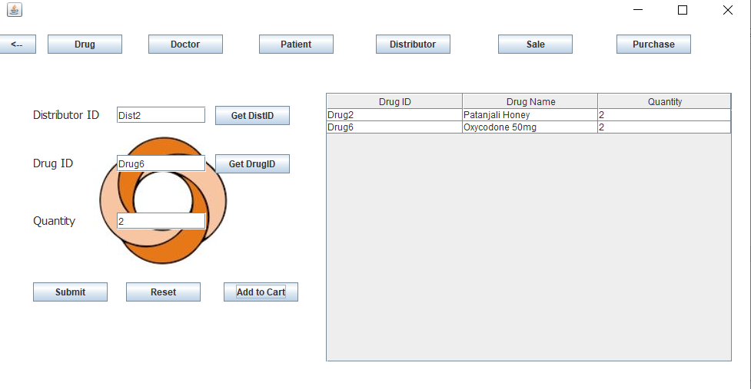
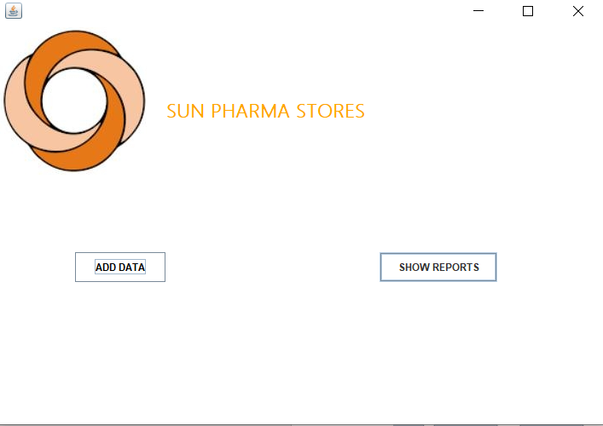
SCREENSHOTS
Purchase Table
Back

Slide 16
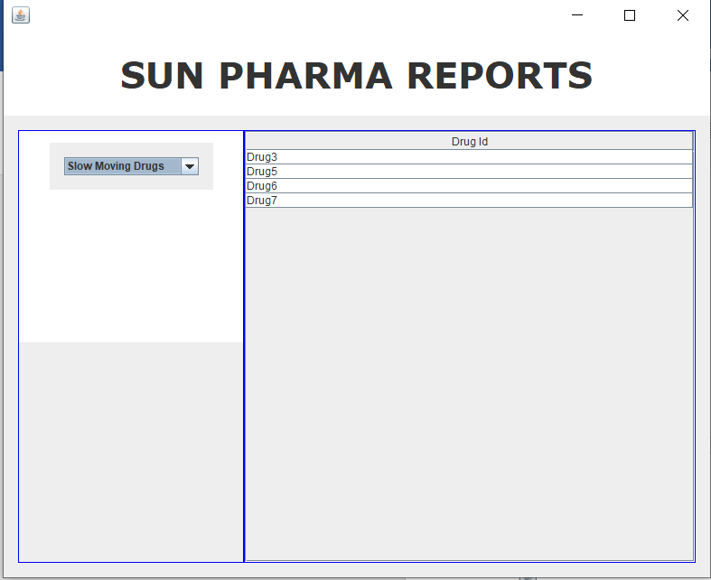
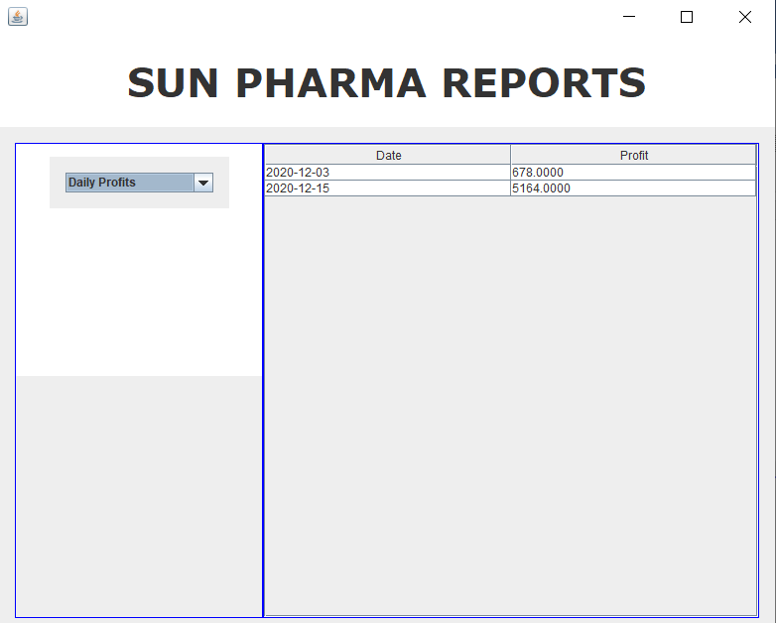
SCREENSHOTS
Slow Stock Report
Daily Profit Report

Slide 17
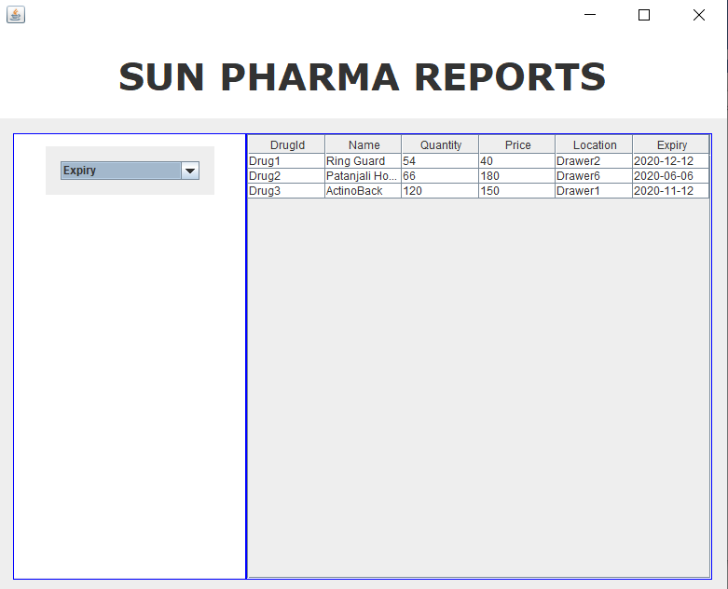
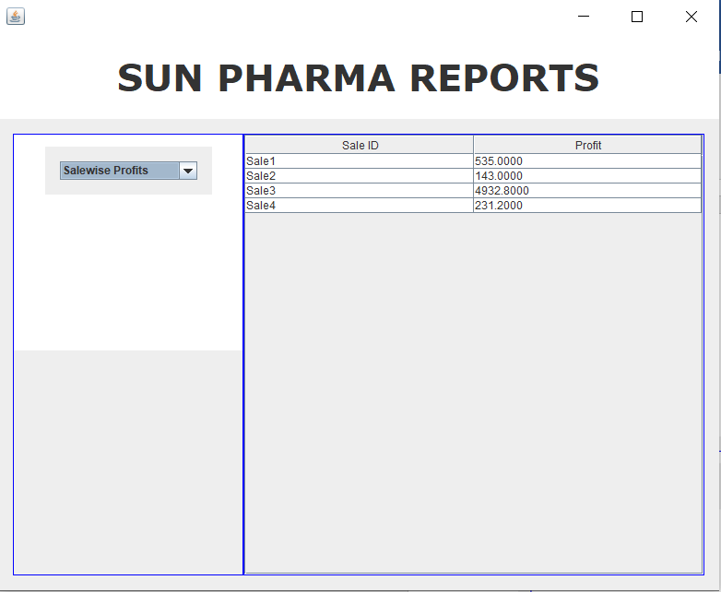
SCREENSHOTS
Expiry Report
Profit Report

Slide 18
SUMMARY
Pharmacy management system is designed to improve the accuracy, enhance safety and efficiency in the pharmaceutical store. It is a computer based system which helps the Pharmacist to improve inventory management, cost, medical safety etc. Pharmacy management system was developed to ensure the security of information and reliability of Pharmacy records when accessing and providing services to the customers. The information gathered during the data collection was properly analysed and the results provided the basis for the new system. The system was tested and found to be functional and the outputs produced by this system were encouraging. The application will hence reduce the loss of information unlike the existing system and also information will be processed fast.

